Slide 1
New results/MS outline
12.2.20
Notes:
Goals for getting out of lab meeting:
Feed back for test choices
Push to write and distribute a draft of my results outline
Practice summarizing results

Slide 2
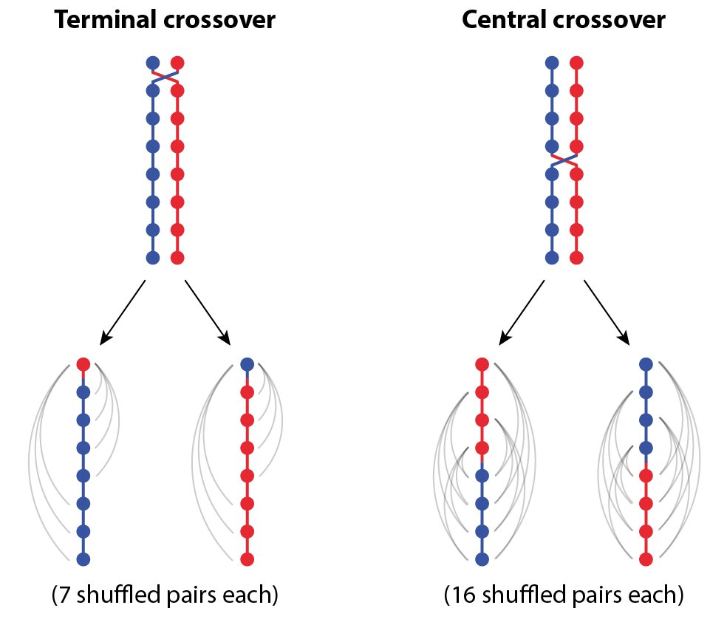
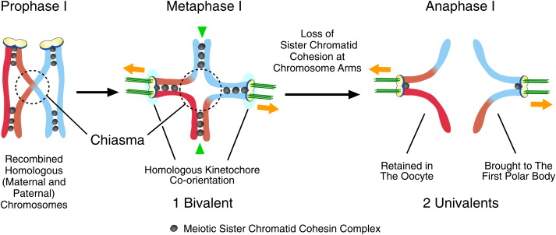
Evolution of Recombination Rates
Indirect selection
Direct selection
2n -> 4n -> 2n -> 1n
Veller, Kleckner, and Nowak Proceedings of the National Academy of Sciences 116.5 (2019): 1659-1668.
Kudo, Nobuaki R., et al. "Resolution of chiasmata in oocytes requires separase-mediated proteolysis." Cell 126.1 (2006): 135-146.
Direct selection
Notes:
Types of evolution of recombination
-- indirect effects – genetic diversity (veller figure
Genetic variation – novel combinations of alleles, escaping from Muller’s ratchet
-- direct effect -- segregation at MI, cohesion + CO = chiasmata facilitates tension force needed for proper segregation.
Known sex differences at these levels for recombination
1) Males/sperm produce recombinate chromsomes with more telomeric places COs
2) Egg’s have higher segregation errors (esp mammals)

Slide 3
Genome wide RR in house mouse
Notes:
How I’m studying sex differences in rec evolution
-example of spreads – cytological approach
- House mouse is great model for evolution – natural populations all over the world – and deep history as a resource for genetic /biological research
Mammals are easy to dissect across life stages – which is needed to get embroyonic ovaries at the right stages of meiosis
MLH1 are COs, mammalian cells are big and protocols for making cell spreads work well.

Slide 4
MLH1 count per cell
Ran Mixed model
Lmer( mean_co ~ subsp * sex + (1|strain) )
ALL 4 Effects are significant
glm( mean_co ~ subsp * sex * strain) )
glm( mean_co ~ sex * strain) )
G strain, PWD*male, and MSM*male are most sig effects
Molossinus
Musc
Dom
Notes:
Review all the logic and results for the models of the whole data set.MLH1

Slide 5
Female MLH1 Means
glm( mean_co ~ subsp * sex * strain) )
glm( mean_co ~ sex * strain )
G and MSM are most significant strain effects;
G is 10% higher
MSM is 8% high
(LEW is 3% higher)
Molossinus
Musc
Dom
Notes:
Put the sex specific results here
Ran glms
G, MSM have most significant p.vals for strain effect
Lew very slight straing effect
Mean G is 10% higher than the average female mean
MSM is 8% high
(LEW is 3% higher)
Variance models → females have significantly larger between cell MLH1 count variance
G mean 28
MSM 27
MOLF 27
But I think with the difference number of mice, this is how the lm shakes out

Slide 6
Male MLH1 Means
glm( mean_co ~ subsp * sex * strain )
glm( mean_co ~ sex * strain )
PWD, MSM and SKIVE significant strain effects
20%, 30%, and 11% higher than other means
PWD, MSM and SKIVE labeled as ‘High Rec’
Molossinus
Musc
Dom
Notes:
Glm’s
PWD, MSM and SKIVE have significant strain effects, they are know high rec strains

Slide 7
Double Strand Break Counts
 |  | cells | mean
WS |  | 21 | 177.7619 | L
G |  | 19 | 158.1579 | L
*PWD | High | 18 | 180.2222 | L
*MSM | High | 17 | 231 | L
KAZ |  | 1 | 159 | L
WSB |  | 20 | 144.25 | Z
G |  | 9 | 131.7778 | Z
*PWD | High | 18 | 140.7778 | Z
*MSM | High | 17 | 164.4118 | Z
KAZ |  | 11 | 167.3636 | Z
Expected time point differences
High strains are significantly higher at Leptotene (earlier stage)

Slide 8
Notes:
-intro for chromosome proportions
-chisquare tests for difference in proportions
-high strains (G and MSM) and (PWD, MSM, SKIVE) – have significantly more 2CO bivalents
(gwRR evolution is facilitated through chrm levels)
(what about the female findings: G, MSM, )
**MSM 60% > PWD 50% > SKIVE 30% > 20 - 10% remaining (low) strains**
Male pattern
**MSM 60% > PWD 50% > SKIVE 30% > 20 - 10% remaining (low) strains**
Female pattern
High female strains, G and LEW,
High Rec females have more 2CO chrms, ~33% vs (23% - 27%)
Male pattern
**MSM 60% > PWD 50% > SKIVE 30% > 20 - 10% remaining (low) strains**

Slide 9
(summary of cell wide meterics)
Rapid sex specific evolution of gwRR (esp male, Musc and Mol)
(Marker for DSB – may start with upstream)
Notes:
TRANSITION TO SINGLE BIVDATA SET

Slide 10
Single Bivalent Dataset
~ 10,400 Automated Single Bivalent Measures
(Curated to make sure the algorithm ran correctly)
3 types of metrics
1. Length of individual bivalents (SC signal)
2. Position of single CO on a bivalent
3. Interference strength, InterFocal Distance (IFD)
Notes:
Example to illustrate the Bivalent Data
Almost all the mice used in the MLH1 data set – have Bivalent observations
Automated measures that have been curated by a human
Not all images isolate or use every bivalent across cells (average 17) – but the isolation isn’t biased and since there so many observations – we assume the bunches of bivalents from each group are similarly representative of general patterns

Slide 11
Single Bivalent Sex Specific Patterns
Q1) What are the main differences between males and females?
Predictions
1. SC length will be sexually dimorphic
2. 1CO normalized positions will be sexually dimorphic
3. No sex difference in physical distance (SC units, (IFDraw)) between foci on the same bivalent.*
*only 1 paper with cytological data for IFD of both sexes (B6). No difference found in physical (um) scale.
de Boer, E., Stam, P., Dietrich, A. J., Pastink, A., & Heyting, C. (2006). Two levels of interference in mouse meiotic recombination. Proceedings of the National Academy of Sciences, 103(25), 9607-9612.
Notes:
(motivation)
Given the findings with the gwRR -> chrm proportions -> look at single bivalent pattern
(chromatin compaction, interference and known sex specific rec landscape features)
(Brief summary for dataset)
(Focus is on 2 main questions)
Animate so that they appear sequentially, then ii) fades
Example questions
Walk through these predictions:
The first 2 are well supported by the literature, while the 3rd there is only 1 paper I could find with cytological data for interfocal distance for both sexes.

Slide 12
Q1 – outline for results
List the motivating statements for each of the metrics
Similar models to the MLH1 resulkts
I’m not going to show the tables of p values ect --- save time copy pasting into power point – instead --- summarize the main points
-- and send out the Results draft

Slide 13
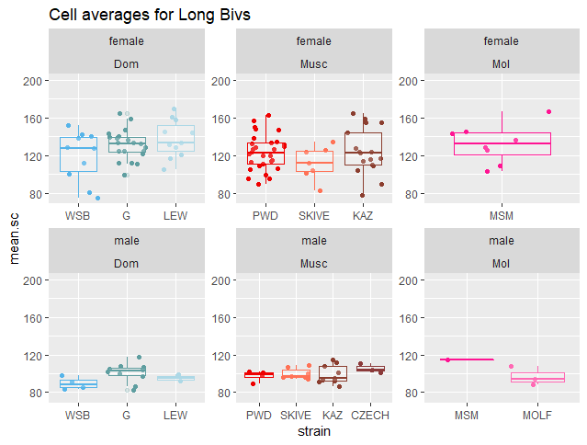
Q1 SC Lengths
Caveats due to XX, but several reasons that support female SC’s being longer:
Within a cell, all bivalents are longer
Long biv measures
(short.biv will also be longer, w/out XX effect)
Notes:
Explain caveat which come from comparison SC lengths across sexes
The XX is like an extra autosome, since it’s a larger bivalent –it will bias the a mean. (in the case of sc lengths being the same across sexes – and only difference is the sample size for calculating the mean, an extra sample above the mean will make the means different (if XX was middle sized there would be no effect)
Why
Use cell average Long bivs in models

Slide 14
High rec males: Sharp threshold of normalized IFDs ~ 30%
Females: enrichment of shorter normalized IFDs
Sim means, for raw IFD
Male mean greater
--- Threshold for the males, not in the females

Slide 15
Threshold not as strict --- in ‘low’ rec straions

Slide 16
Q1 results summary (model results)
Average bivalent SC length longer (even with XX) in females
-model results, sex fixed effect was most consistently significant
Interference, IFD measures
-Generally females have longer rawIFD, but PWD*male and SKIVE*male had the most significant pvalues (longer raw.IFDs) indicating these strains have a reduced degree of sexual dimorphism
-males have longer nrmIFD
Nrm.F1.pos
1COs in females have more central position, and telomeric in male
Male is the most consistent significant effect. (the rest of the results for these models are kinda muddy)
Notes:
SC length notes
-longer average bivalent lengths,
All bivalents within a cell are longer
Permutation sampling of 19 female random bivalents (compared to male permutations of random sample of 20) – these permutations don’t have similar means. Adding or taking away an extra ‘autosome’ doesn’t change the mean bivalent calculations – enough to overlap with the other sex
Interference
-low number of significant effects for both raw and normalized IFD
-Generally females have longer rawIFD, but PWD*male and SKIVE*male had the most significant pvalues (longer raw.IFDs) indicating these strains have a reduced degree of sexual dimorphism
-Male effect was most significant effect for nrm.IFD
- MALES have longer nrm IFD – which fits with linkage map measures, interference being stronger in males (weaker in females) – I don’t understand how linkage map interference patterns translate to nrm.IFD since there aren’t genomic locations
The overall narrative I’m trying to weave – more variance in females
-Between cells (MLH1 counts)
- Uniform spacing (the 1CO position is not regulated) (F1 variance is probably larger (F1nrm))
- IFD spacing / interference strength
- Lack of distinction between 1CO and 2CO lengths
(longer SC lengths (variance in SC length / I’m not sure this makes sense))
deBoer Summary:
MSH4, in WT and Sycp1 -/-. (found 2 classes of COs / two types of interference). Used FISH for chrms 1,2,18,19; calculated gamma distribution from chrm specific intervals
Interference much stronger for MLH1 in pachytene
Sex differences --- ?
(the density of MLH1 on SC-AE is more dense in males than females)
Male – short chrms had strong medial placement of MLH1
(Can I access these data?)

Slide 17
Single Bivalent High and Low rec groups (Male )
Q2) What are the differences between high musc and low musc strains?
Bivalent metric predictions
1. Interference will be weaker in High.Rec strains (IFD will be shorter)
2. SC length will be longer in High.Rec strains
3. 1CO normalized positions will not be different
Expected patterns based on MLH1 results, for SC length and IFD (opposite for interference).
A. Dom, (WSB = LEW = G)
B. Musc, (PWD > SKIVE > KAZ, CZECHII )
C. Mol, (MSM > Mol)

Slide 18
Main Results for Q2 (outline / summary)
(List the motivating statements for each of the metrics

Slide 19
Caveats / Complications
Mean Bivalent SC Length
-average bivalent lengths are confounded by the different proportions of chromosome classes in the High.Rec and Low.Rec strains
Solutions
-testing whole cell measure of SC
-testing long.biv and short.biv (regardless of chromosome classes). Top 5 and bottom 5 bivalents from single cells.
Notes:
Classes of chromosomes (1CO, 2CO) already have expected SC length differences (based on their physical MB size.
High.Rec strains have more 2CO bivalents – their 1CO pool will have shorter bivalents, and 2CO will be
Low.Rec strains have more 1CO bivalents – this pool will include a range of short and long bivalents
If I compare the average sizes of bivalents divided by classes ---

Slide 20
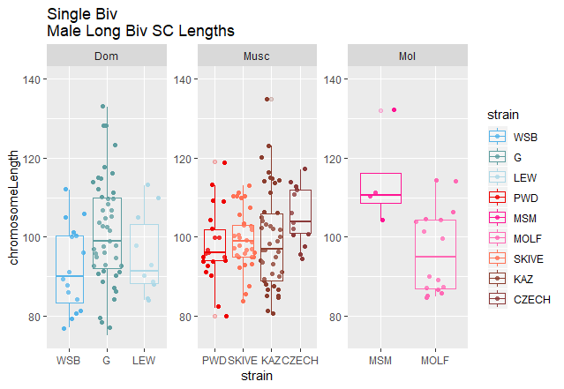
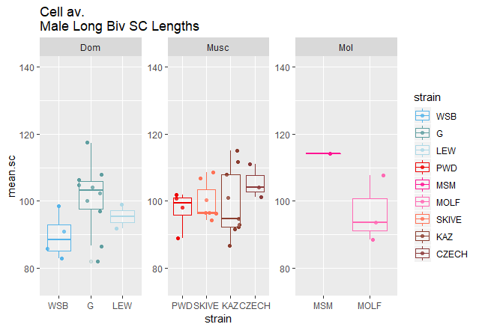
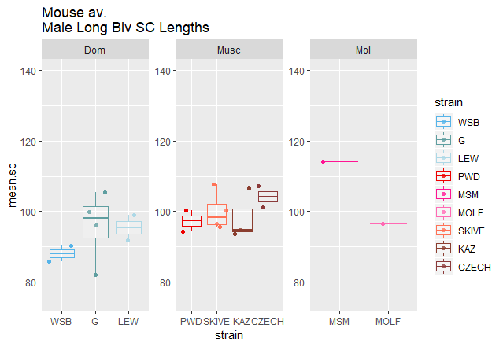
Long Biv SC Length Means
All bivalents with SC longer than 4th quartile for SC length distribution of 1 cell.
Limited by automated measures with >16 bivalent measures per cell
~5 cells per group
Single Bivalents
Cell averaged
Mouse averaged
Notes:
At first I thought this comparison
This comparison should make sense because the bivalents are being filtered by sc length in comparison to the other bivlents within the same cell.

Slide 21
Long Biv SC Lengths
Notes:
SKIP THIS JUST FOR display
At first I thought this comparison
This comparison should make sense because the bivalents are being filtered by sc length in comparison to the other bivlents within the same cell.

Slide 22
Summary
Rapid male specific evolution of gwRR (average MLH1 count per cell) is associated with:
High.rec strains have longer SC, more DSBs, and stronger CO interference
Sexual dimorphism for single bivalents traits – pretty conserved
Average bivalentSC lengths longer in all strains
Interference weaker (raw)
High.rec strains have longer SC, more DSBs, and stronger CO interference

Slide 23
Overall summary
Female traits have more variance (may have relaxed selection compared to males)
Number of MLH1 foci per cell – much higher variance (some cells with below min some cells with many
(range of chromosome classes greater in females)
Longer SC and sparser CO placement
Weaker interference -> more uniform Rec.Landscape
Males (traits might be more tightly regulated)
Shorter SC, smaller range in SC across bivalents
Strong interference and position bias make consistent Rec.Landscapes
Males Rapid evolution for the total number of COs per cell – but the RE.Landscapes across all the bivalents might be more similar compared to females
Notes:
Female traits have more variance
-longer SC but less dense
-weaker interference -> more uniform rec landscape
-number of MLH1 foci per cell – much higher variance (some cells with below min some cells with many
Males (traits might be more tightly regulated)
- strong interference --
- Telomeric position of 1CO
- ()str
Rapid evolution for the total number of COs per cell – but the rec.landscapes across all the bivalents might be more similar compared to females

Slide 26
Glm M2, and main points
G strain, G*male effects, driven by large difference between male and female means.
PWD*male and MSM*male driven by male specific elevate rates
No SKIVE strain effect, no sex difference between male and female strains. Analysis of only male data, SKIVE strain is significant.
glm(mean_co ~ sex * strain, data=DF.HetC.MixedModel.HQ)
 | Estimate | Pr(>|t|)
(Intercept) | 24.71164 | 1.28E-87
Sex male | -0.15644 | 0.822008
strainG | 3.297524 | 1.95E-06
strainLEW | 1.696468 | 0.019408
strainPWD | 1.158224 | 0.065356
strainMSM | 2.977214 | 6.95E-06
strainMOLF | 2.907357 | 0.096333
strainSKIVE | 1.226357 | 0.480969
strainKAZ | 0.85569 | 0.234412
sexmale:strainG | -3.17191 | 0.001651
sexmale:strainLEW | -1.19095 | 0.278086
sexmale:strainPWD | 3.592951 | 0.000535
sexmale:strainMSM | 3.723836 | 0.001962
sexmale:strainMOLF | -3.22256 | 0.09905
sexmale:strainSKIVE | 1.454443 | 0.460095
sexmale:strainKAZ | -0.80789 | 0.43176

Slide 27
DMC1 Results

Slide 28
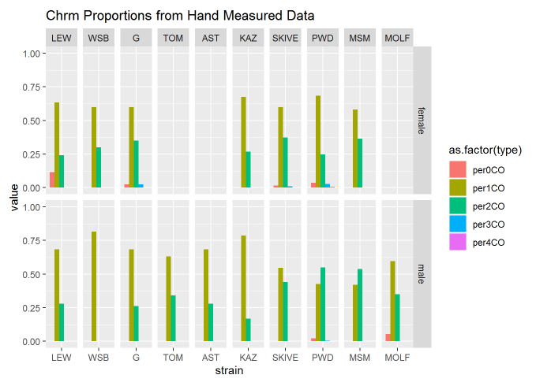
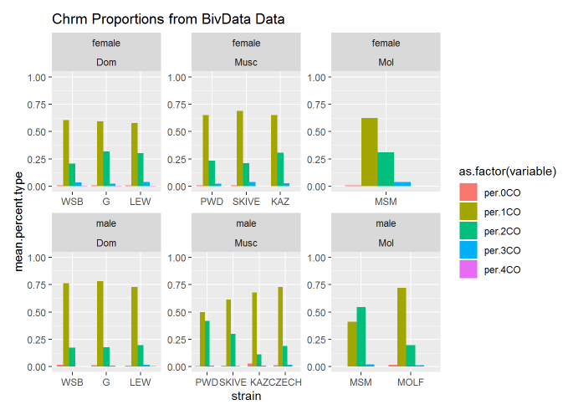
Chromosome proportions
The mice with distinct gwRR

Slide 29
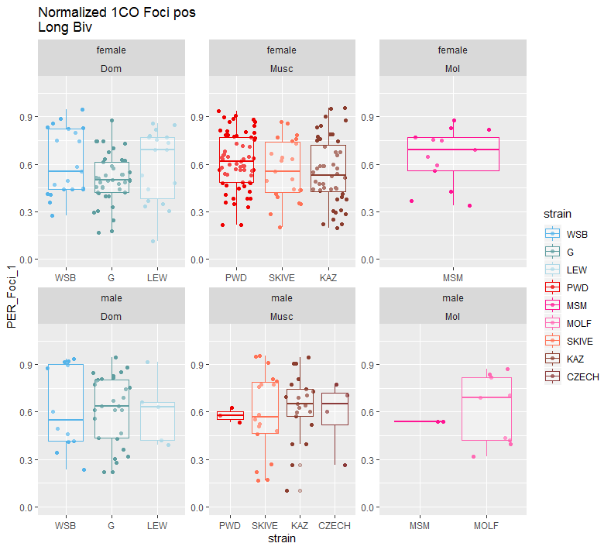
Normalized 1CO Foci Position Long Biv
To control for chromosome size effect, use LongBiv observations.
- Controls for SC difference
(more) control for chromosome identity
Make a table

Slide 30
Q2 Caveats / Complications part II
Normalized F1 Position
-there’s more chromosome size effects – complicating things.
(small (Mb) chrms usually have more uniform CO position landscape)
Solution
-measures in long and short biv groups

Slide 31
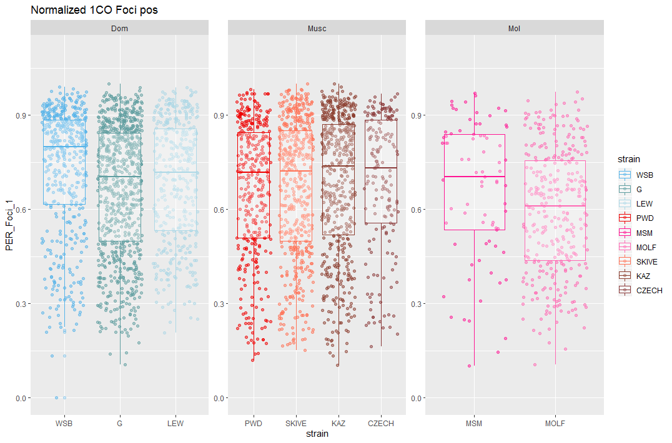
Normalized 1CO all Bivs
Normalized F1 Position
Notes:
Don’t trust --- these measures --

Slide 32
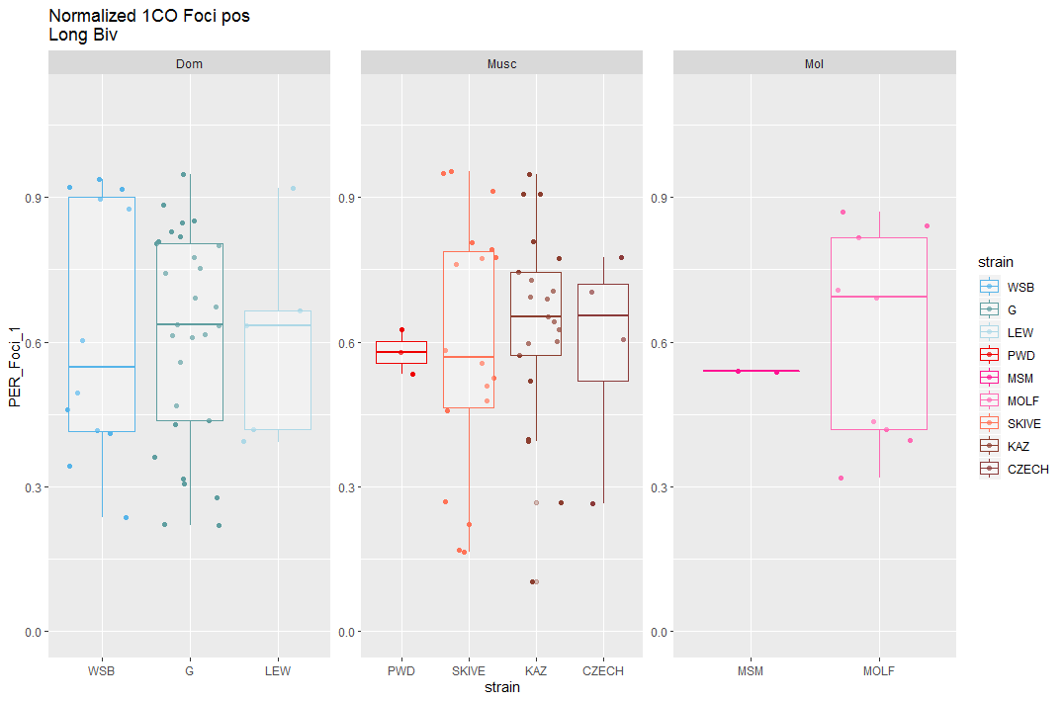
Normalized 1CO LongBiv’s
Normalized F1 Position
Each point is a bivalent with 1CO
(multiple mice rep)
Notes:
Pattern almost reversed
WSB has lowest mean
To control for chromosome size effect, use LongBiv observations.
- Controls for SC difference
- (more) control for chromosome identity

Slide 33
Nrm.F1.pos Mouse av. Long.Biv
General pattern of
High.rec strains having more central F1 pos is kinda met
Normalized F1 Position
Each point is a MOUSE average of all the Long.Biv measures
Notes:
I guess the mouse averages do indicate that higher rec strains have more centromeric F1 pos.
Each point is a mouse

Slide 34
Summarize sex specific bivalent patterns
(figure ideas?)
Main data / tables
Conserved sex specific metrics for single bivalents during meiosis
- SC compaction
- uniform CO placement
Surprise, interference is not conserved… (raw value long in females, normalized versions females have sub class of close together
General pattern – for revisiting in discussion
Female meiotic pathway is less controlled/regulated
Notes:
The overall narrative I’m trying to weave – more variance in females
-Between cells (MLH1 counts)
- Uniform spacing (the 1CO position is not regulated) (F1 variance is probably larger (F1nrm))
- IFD spacing / interference strength
- Lack of distinction between 1CO and 2CO lengths
(longer SC lengths (variance in SC length / I’m not sure this makes sense))

Slide 35
SC Length
1. Dom are different
2. Musc strains? (PWD and SKIVE most different)
Inter-
Focal
Distance

Slide 37
-lme4 (use RLTR exact() for testing random effects --- what are the random effects in these models?
-ANOVA? (one way anova – 1 factor in this group is different from the others
fit <- aov(y ~ A, data=mydataframe)
ANOVA test hypotheses:
Null hypothesis: the means of the different groups are the same
Alternative hypothesis: At least one sample mean is not equal to the others.
http://www.sthda.com/english/wiki/one-way-anova-test-in-r
Non-sig anova
Sig anova
Sig anova
Pairwise t.test results for the 3 subsp
Notes:
Discussion
Table X, Current models and their predictions for the evolution of heterochiasmy
Table X, results from proposed predictions
(Figure X, cartoon of difference in bivalent on spindle for 1CO and 2COs)
Review main patterns
Male specific polymorphism for gwRR in musculus and molossisnus, may not be a species wide optimum for gwRR
More variance in females for meiotic features, resulting in greater variation in gwRR
Rapid male specific evolution upstream of CO repair stage
SACE predictions and bivalent selection models are not mutually exclusive,
Importance of broad scale patterns for recombination
(centromere effects for mis-segregation rates) - (high rate of robertsonian translocation in Dom, and absent in Musc – maybe something about centromeres (encourages transloactions + suppresses 2CO (rec near centromere) in DOM
(that has changed in Musc, REC near centromere suppresses rates of robertsonian translocation)
Discussion
Table X, Current models and their predictions for the evolution of heterochiasmy
Table X, results from proposed predictions
(Figure X, cartoon of difference in bivalent on spindle for 1CO and 2COs)
Review main patterns
Male specific polymorphism for gwRR in musculus and molossisnus, may not be a species wide optimum for gwRR
More variance in females for meiotic features, resulting in greater variation in gwRR
SACE predictions and bivalent selection models are not mutually exclusive,
Importance of broad scale patterns for recombination

